Slide 1
Protein-Protein Docking
Benchmark three protein docking tools
Yifu Yao Yiwei Lu
Tianqi Wu Anes Ouadou
Notes:
Good afternoon, everyone. The title of my presentation today is about the results of our project 3 : protein-protein docking. I’m Yifu. My group: Tianqi, Anes, and Yiwei,

Slide 2
Contents
Docking Targets
Methods and Tools
Optimization
Results and Evaluation
Visualization
Notes:
Here are the main contents I’m going to discuss today. First, I’m going to introduce the docking targets including which targets we selected and why we selected them, Also, some pretreatment of these targets is in this part. Then it is the section about what methods and tools we used and how we used them. And in the third and forth section, I’m telling you how we deal with optimization and visualization. The last section, our results and evaluation.

Slide 3
Docking Targets
Two targets from CAPRI
T116
T120
Notes:
Ok, first section, docking targets. We selected two docking targets from CARPRI, T116 and T120. The list shows the basic information about these two targets. We selected these two targets because they have different oligo. T116 has 2 but T120 has 1+1, which means T120 has two units with totally different structure but T116 is not. I’m going to tell more details about them.

Slide 4
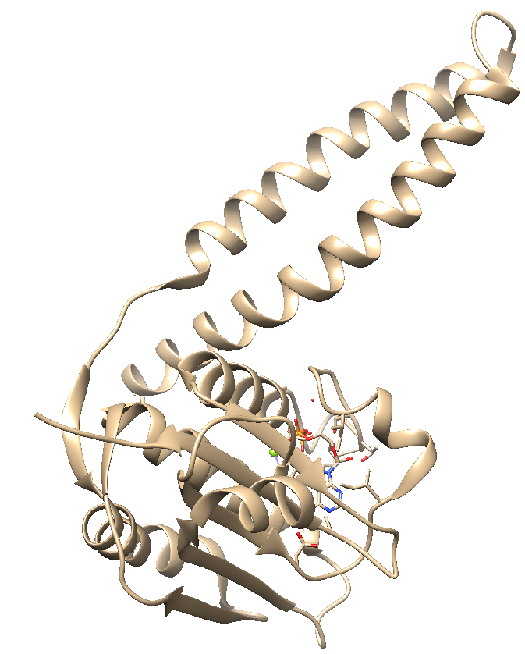
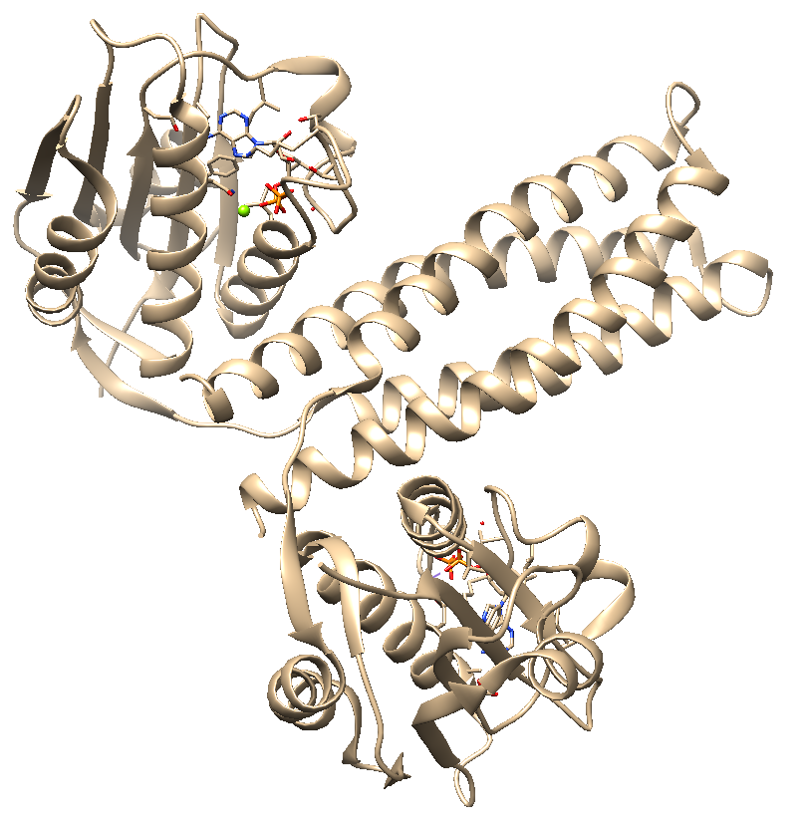
T116
Oligo: 2
Receptor Molecule:
Ligand Molecule:
Offical Result Module:
5IDJ Unit
5IDJ Unit
5IDJ Assembly
Notes:
Each target needs a receptor molecule and a ligand molecule to dock. For T116, as mentioned before, its pdb file is 5IDJ. We separated it into two units and found they have same structure. Just like that. We used one unit as receptor and one as ligand. Then the whole module is the offical result and we used it in our scoring part.

Slide 5
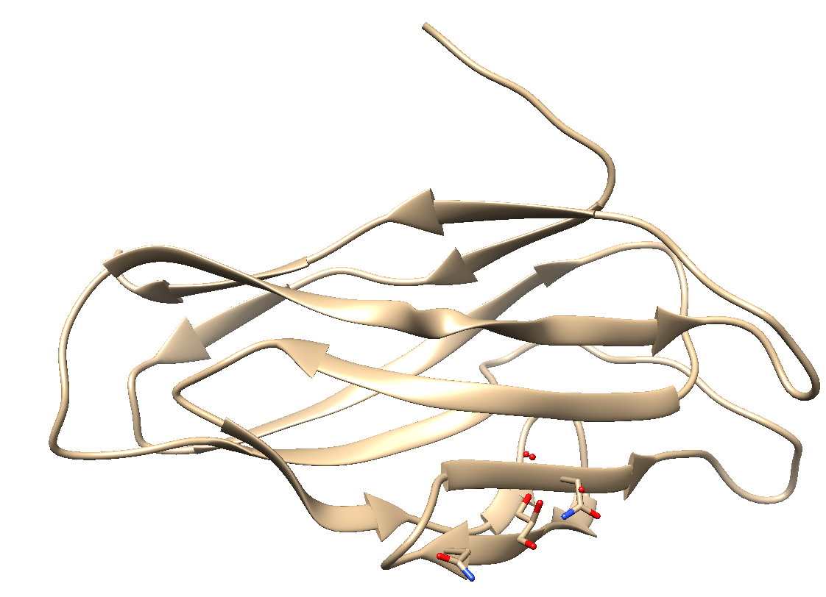
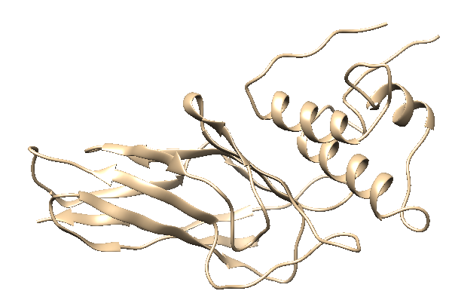
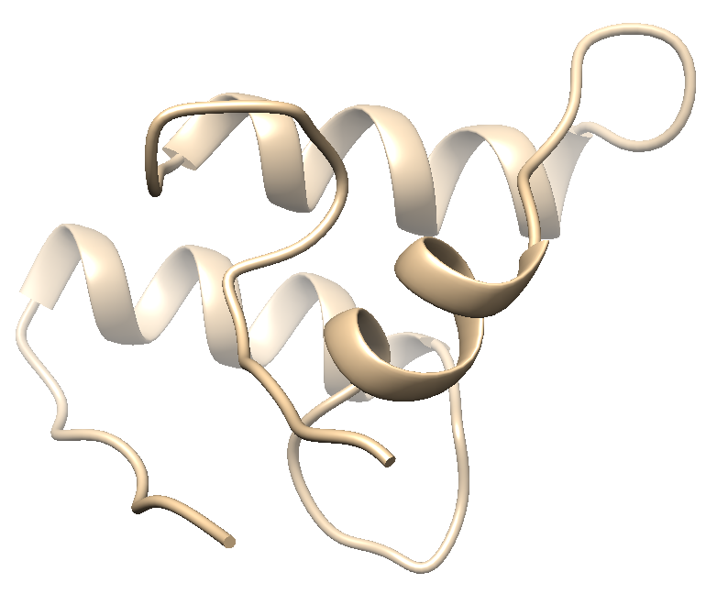
T120
Oligo: 1+1
Receptor Molecule:
Ligand Molecule:
Offical Result Module:
5AOZ
MGSSHHHHHHSSGLVPRGSHMASVQKFPGDANCDGIVDISDAVLIMQTMANPSKYQMTDKGRINADVTGNSDGVTVLDAQ
FIQSYCLGLVELPPVE
A Sequence
5M2O
Notes:
As for T120, it is different with T116. Its oligo is 1+1 but 2 which means the receptor of T120 is not the same as its ligand. The receptor is very easy to get, CAPRI told us it is 5AOZ. However, the ligand we can get from CAPRI is only a sequence. We put the sequence into Modeller web server and get a predicted ligand molecule. And another thing we got from CAPRI is the official module , 5M2O.

Slide 6

Methods&Tools
Methods:
Initial approach
Zdock
ClusPro
Geometric hashing
Patchdock
Advanced high-resolution approaches – model changes explicitly
RosettaDock
Notes:
The three tools we used in this project to create predictions are Zdock, Cluspro and PatchDock. Zdock and ClusPro are initial approaches and PatchDock is based on geometric hashing. Actually, in our original plan, we were trying to use RossettaDock which is a advanced high-resolution approach. Unfortunately, we uploaded but our target was in a waiting queue for a long time until this afternoon. I just received the email saying that It finished the job. In case of such situation, we added ClusPro as a emergent tools and obviously, it works.

Slide 7
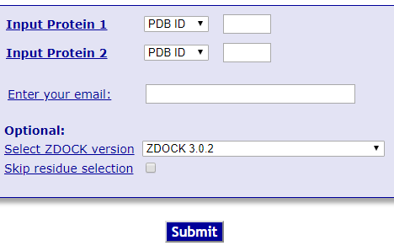
Zdock
Web Server
Fast Fourier Transform – background in mathematics and engineering
Notes:
Zdock is a user-friendly protein docking server, based on the rigid-body docking programs and FFT, fast fourier transform, to predict structures of protein-protein complexes and symmetric multimers. Here is a screenshot of Zdock. Uploading a receptor and a ligand, filling a email address into it and submitting. That’s all, it is very easy to use.

Slide 8
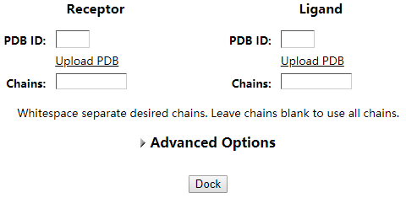
ClusPro
Web Server
Automated rigid-body docking and discrimination algorithm
Notes:
ClusPro is a web server which uses an automated rigid-body docking and discrimination algorithm that rapidly filters docked conformations, and ranks them based on their clustering properties. Look at the screenshot, receptor and ligand are also required. Clicking the Dock button, then it’s finished.

Slide 9
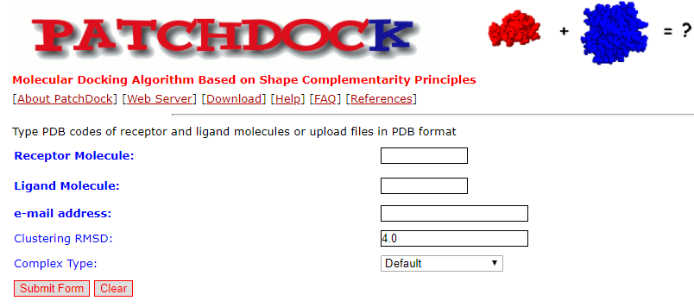
PatchDock
Fast and versatile approach
Speed allows easy extension to multiple protein docking, flexible hinge docking, etc
Notes:
PatchDock is a geometric hashing based web server which provides a fast and versatile approach to dock proteins. Its speed allows easy extension to multiple protein docking, flexible hinge docking and others. Uploading receptor and ligand, as same as the other two tools.

Slide 10

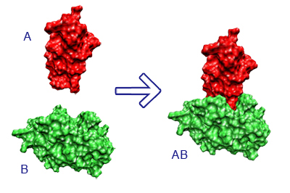
Optimization
Combine tools to improve quality
The results from the three methods will be refined using Firedock
FireDock refines and scores up to 1000 potential docking candidates using an energy function.
Zdock
ClusPro
FireDock
PatchDock
Notes:
Like what we discuss in our plan, our optimization requires us to combine tools to improve quality. We refined all results from all three tools by using FireDock. The simple flowchart shows what we did, a receptor and a ligand as input to these three tools, Then we collect top 10 results from each tool and set them as input into FireDock. Then Firedock refined them and give us its results.

Slide 11
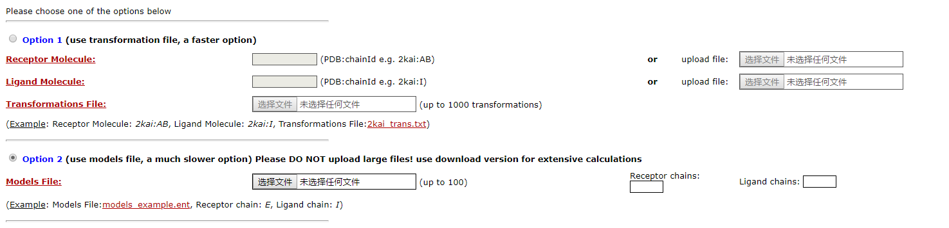
FireDock
Web Server
An efficient method for refinement and re-scoring of rigid-body protein-protein docking solutions.
Notes:
Here is some detail about FireDock. FireDock is an efficient method for refinement and re-scoring of rigid-body protein-protein docking solutions. It has two selected options on its web but what we need to use is the second one because the first option is for normal docking just like Zdock, Cluspro and patchdock, and the second option is for refinement. However, the upload file to refine is only one, so we combined all thirty modules got from Zdock, Cluspro and patchdock into a single file with its required format. Uploading the combined file, and point out the receptor chain and ligand chain, then it can work.

Slide 12
Visualization
Chimera
Notes:
As for visualization, we used chimera. It is a powerful tool to visualize.

Slide 13

Results&Evaluation
Top 10 predictions of each tool
RMSD & TM-Score
Interface of docking part
Notes:
Ok, the final section. In this section, I’m going to show you all results we got from docking tools and the result of evaluation.

Slide 14
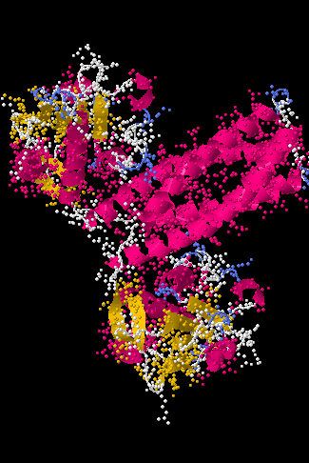
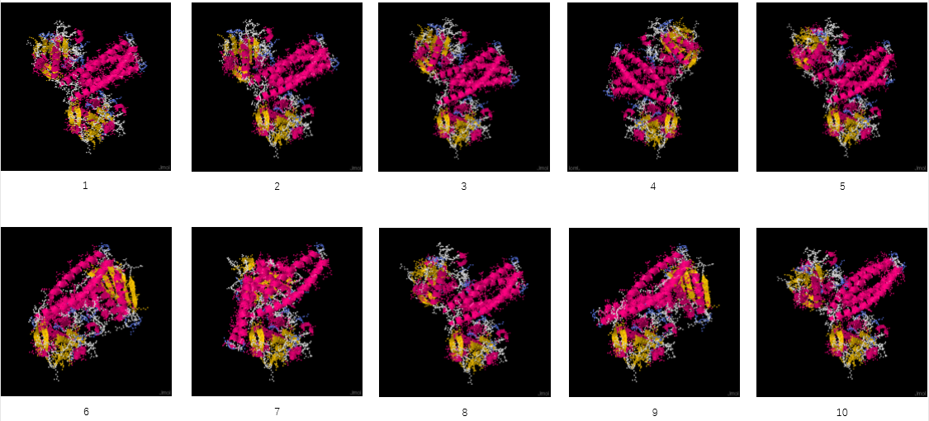
T116
Results of Zdock
Notes:
Results of Zdock of T116. The left one is the best prediction that Zdock created. And the top one is all top 10 results that Zdock created. Maybe it is too small to see clearly. But, yeah, you may can see these main structures.

Slide 15
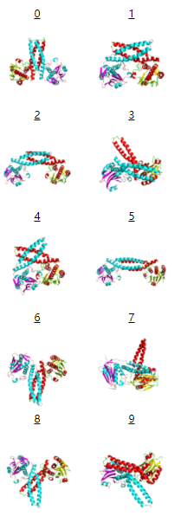
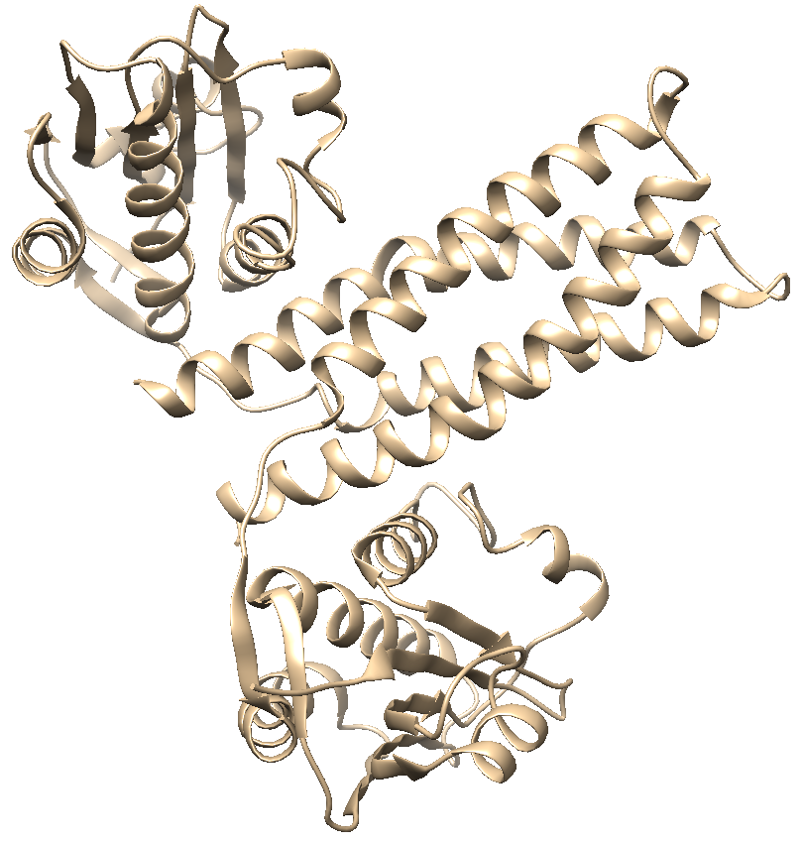
T116
Results of ClusPro
Notes:
It is the result of Cluspro. The right one is the best prediction and the left are all top 10 best results.

Slide 16
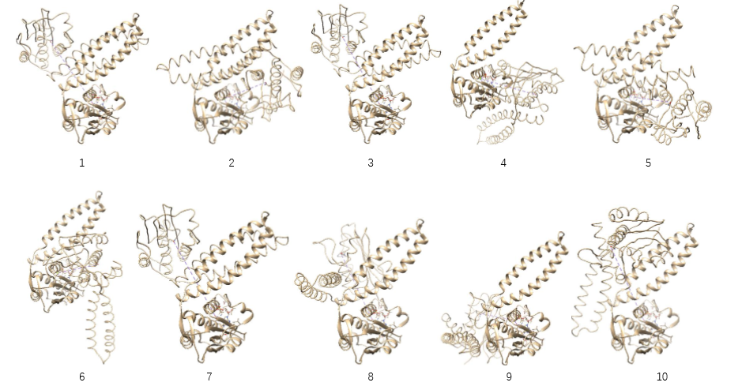
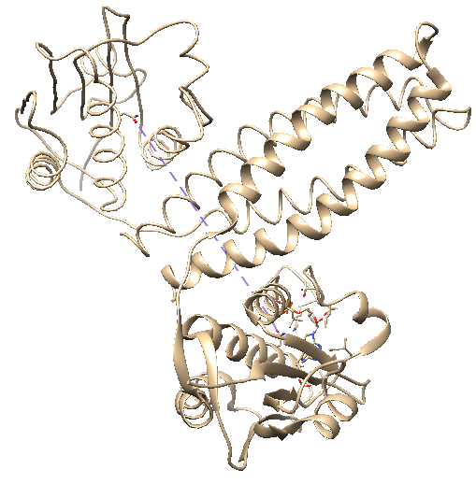
T116
Results of PatchDock
Notes:
Results of PatchDock. The best module PatchDock predicted, and top 10 modules.

Slide 17
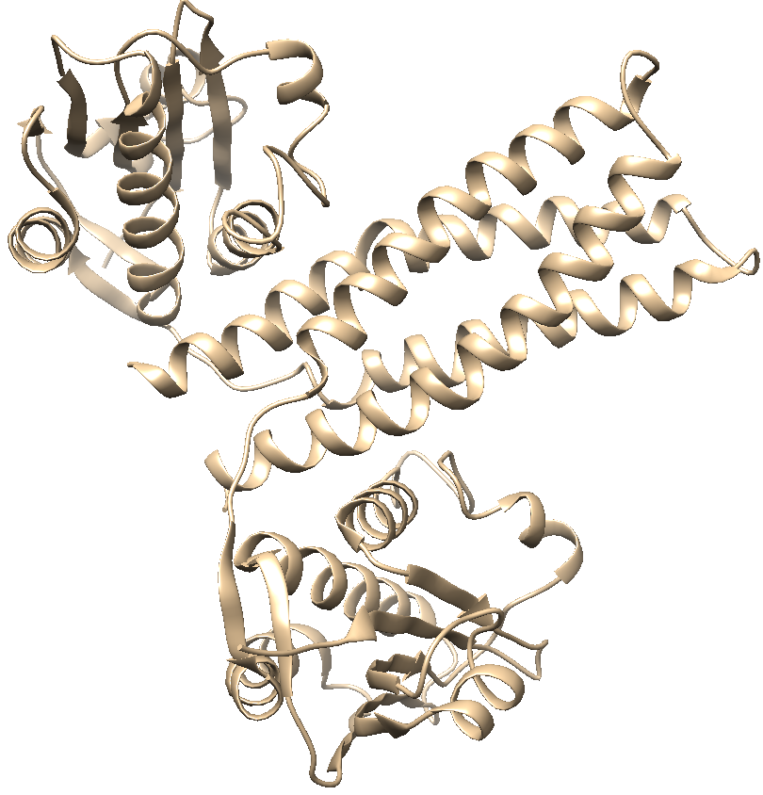
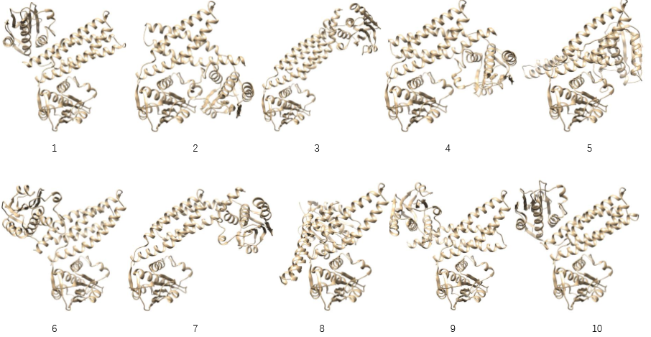
T116
Results of FireDock
Notes:
And the refinement results.

Slide 18
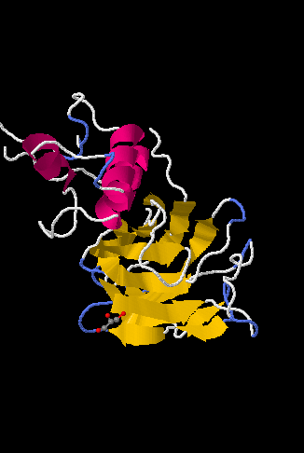
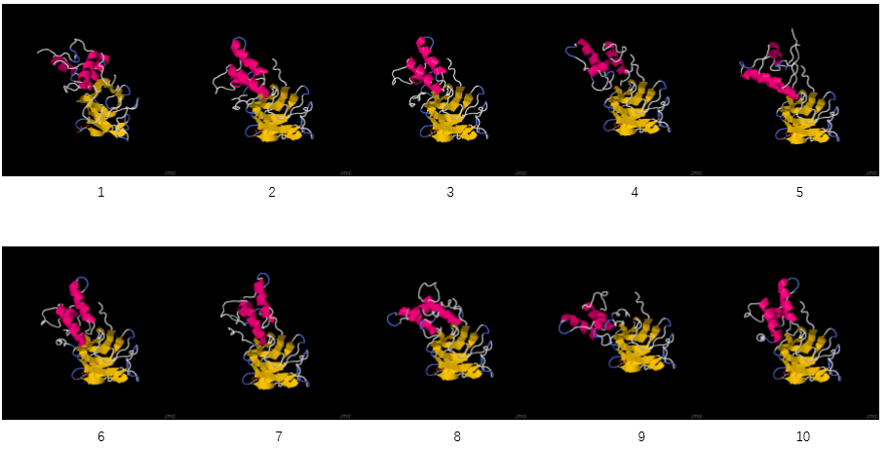
T120
Results of Zdock
Notes:
Now the results of T120. The first is results of Zdock. The best prediction, top 10 predictions.

Slide 19
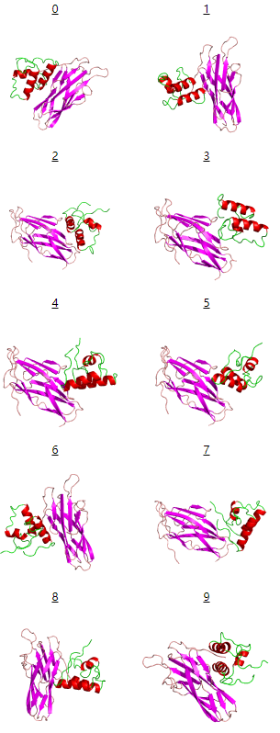
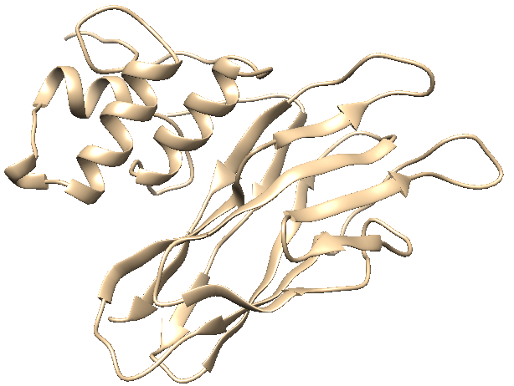
T120
Results of ClusPro
Notes:
Results of ClusPro. The best prediction, top 10 predictions.

Slide 20
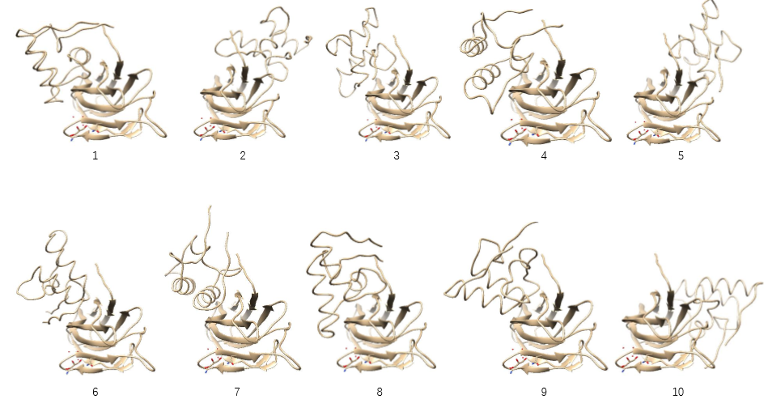
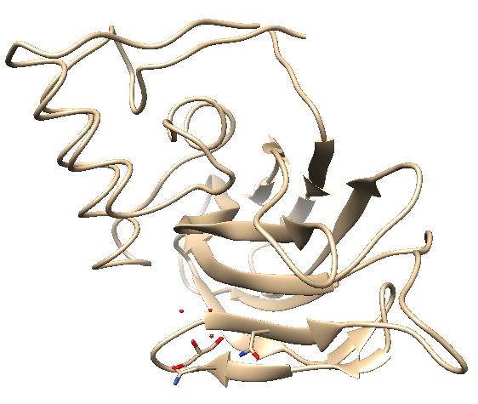
T120
Results of PatchDock
Notes:
Results of PatchDock. The upper picture is top 10 predictions and the below one is the best prediction PatchDock created.

Slide 21
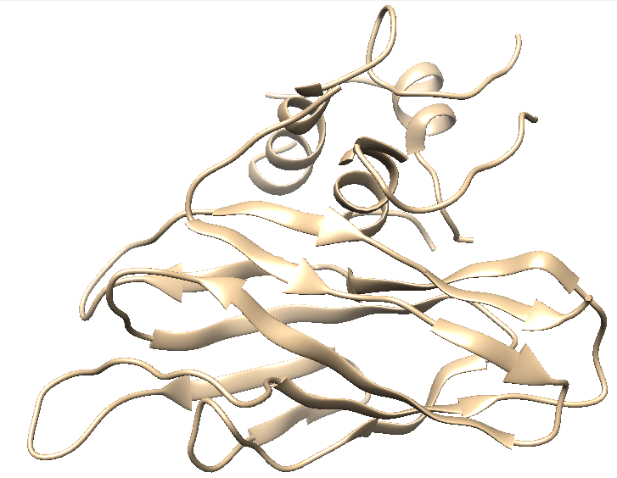
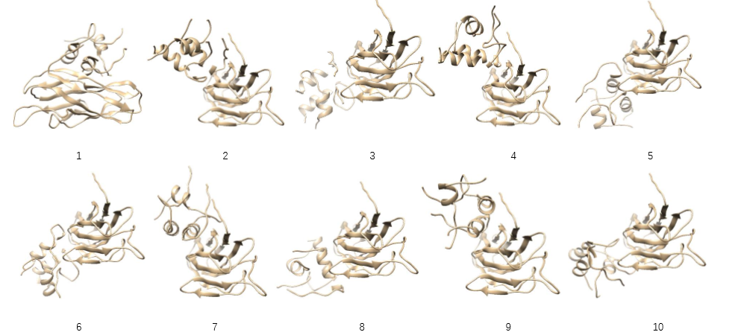
T120
Results of FireDock
Notes:
Finally, the results of refinement. The best module, top 10 modules.

Slide 22
Evaluation&Discussion
T116
T120
 | ClusPro | Zdock | PatchDock | FireDock
RMSD | 0 | 0 | 0 | 0
TM-Score | 0.5 | 0.5 | 0.5 | 0.5
 | ClusPro | Zdock | PatchDock | FireDock
RMSD | 11.769 | ? | 11.878 | 11.897
TM-Score | 0.0980 | ? | 0.0961 | 0.1022
Notes:
Ok, here is evaluation. We calculated RMSD and TM-Score for each best prediction. Look at T116, the amazing thing is all RMSD are 0, means each docking tool created a perfect prediction matches with official module. I know it is a little bit unbelievable, but it is the results. We discussed about the results, and found CAPRI said T116 is a easy case. We think maybe it is the reason. However, T120 in CAPRI is not an easy one, it is a hard case. We didn’t get RMSD and TM-Score of the prediction of Zdock because TM-Score server can’t work with the file from Zdock. But look at the TM-Score, the refinement result has a little improvement but RMSD doesn’t change too much. We may discuss about the result in our future works.

Slide 23
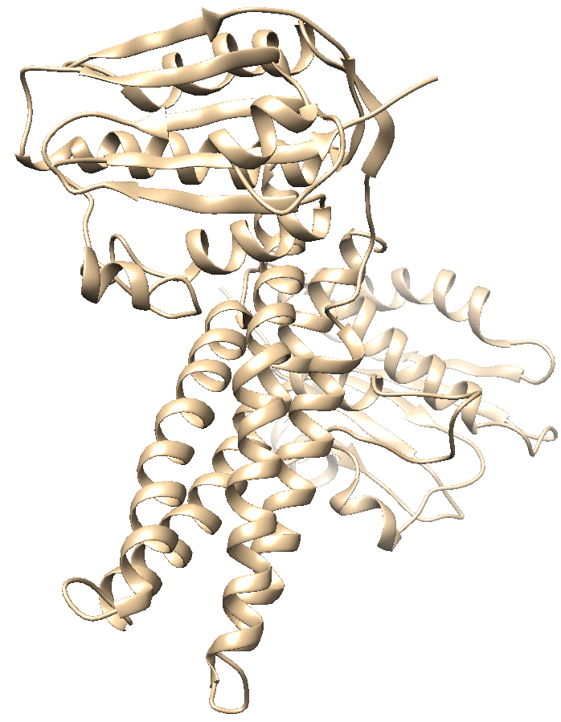
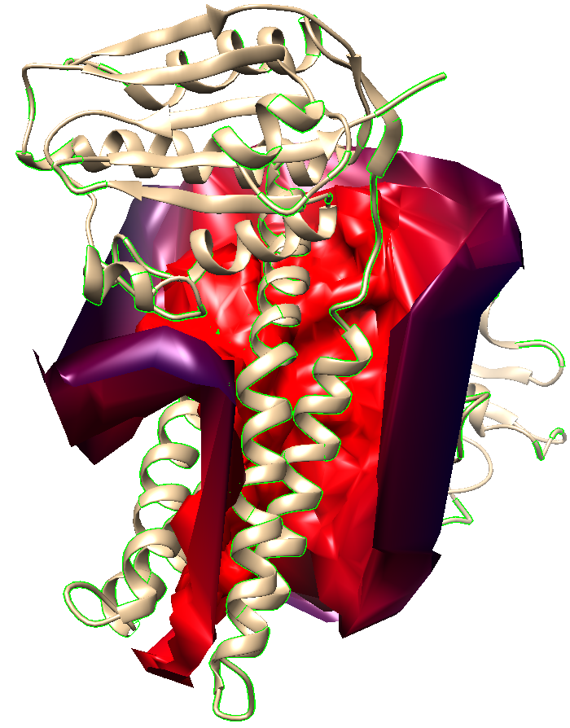
RSMD&TM-Score
Interface
Chimera
Computing interface surface
Selecting interface atoms
Saving selected atoms as PDB files
Notes:
And what’s worth mentioned is how we get the docking interface to calculate score. The method is Chimera. I said Chrmera is a powerful tool because it not only can visualize bu also can compute interface surface. After computing, we selected interface atoms and saved these atoms as PDB files. Just like the picture, for example, T116. Chimera can compute interface of docking part. The red area is dock part and there some yellow parts on the protein which are docking atoms. The picture is too small so the yellow atoms may not clear. In a word, it is the way we get docking interface.

Slide 24
Thanks!

